Slide 1
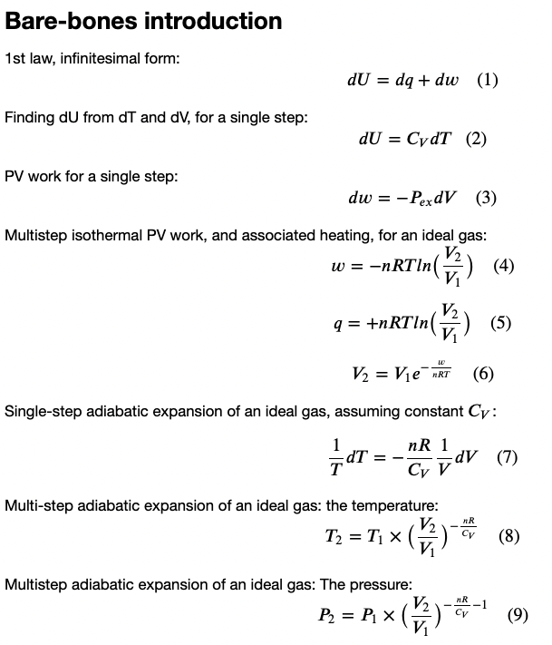
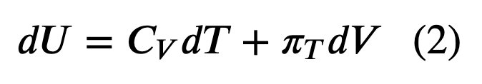
Recap
What we’ve done so far this week
Heat, work, and the 1st Law
Explored how that relates to the behavior of gases as they expand & contract
Constructed Carnot cycles

Slide 2


Let’s draw arrows from the five items on the left (T_{H}, etc.) to places on the right.
$$T_{H}$$
$$T_{C}$$

Slide 3
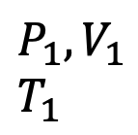



The Carnot cycle is a theoretical heat engine that converts heat into work
$$T_{H}$$
The “working fluid” of a Carnot is an ideal gas
$$P_{ex}$$
$$P_{ex}$$
|Q_{C}|
$$P_{2},V_{2}$$
$$T_{2}$$
$$P_{1},V_{1}$$
$$T_{1}$$
$$T_{C}$$

Slide 4
In practice, thermoelectric power plants use similar ideas (but the working fluid is water)
$$T_{H}$$
|Q_{C}|
$$T_{C}$$

Slide 5
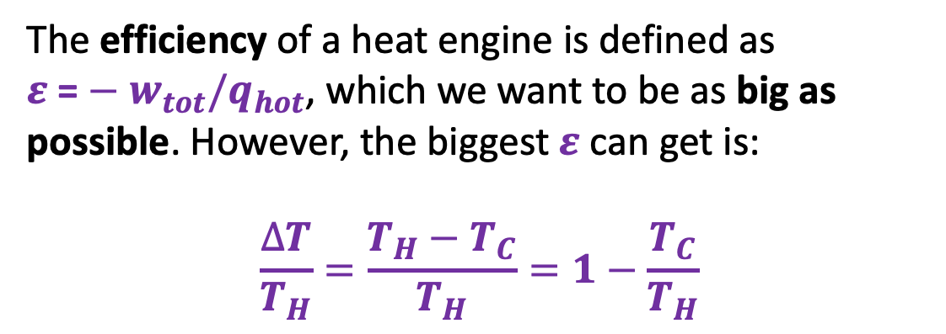
Heat engine efficiency
$$T_{H}$$
The efficiency of a heat engine is defined as ${ε \text{=}−w}_{tot}/q_{hot}$, which we want to be as big as possible. However, the biggest $ε$ can get is:
$$\frac{∆T}{T_{H}}=\frac{T_{H}−T_{C}}{T_{H}}=1−\frac{T_{C}}{T_{H}}$$
|Q_{C}|
$$T_{C}$$

Slide 6
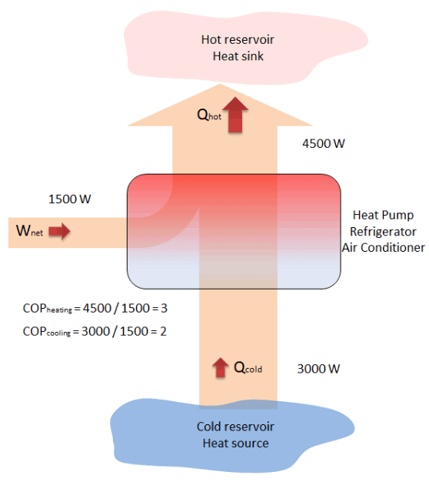


Heat engines vs heat pumps
A heat pump’s job is to use work (electricity) to move heat from a cold place to a warm place.
A heat engine’s job is to convert heat from a hot place (like a furnace) into work (electricity), dumping the waste heat into a cold place (the ocean or something).
Your home
$$T_{H}$$
Outside, on a winter day
$$T_{C}$$
https://www.thermal-engineering.org/what-is-coefficient-of-performance-cop-heat-pump-definition/

Slide 7
Heat engines vs heat pumps
A heat pump’s job is to use work (electricity) to move heat from a cold place to a warm place.
A heat engine’s job is to convert heat from a hot place (like a furnace) into work (electricity), dumping the waste heat into a cold place (the ocean or something).
Outside, on a hot day
$$T_{H}$$
Your home
$$T_{C}$$
https://www.thermal-engineering.org/what-is-coefficient-of-performance-cop-heat-pump-definition/

